Slide 1



Predicting Airbnb New User Bookings
Nicole Reitz
General Assembly
DAT_BOS_07
25 January 2016

Slide 2
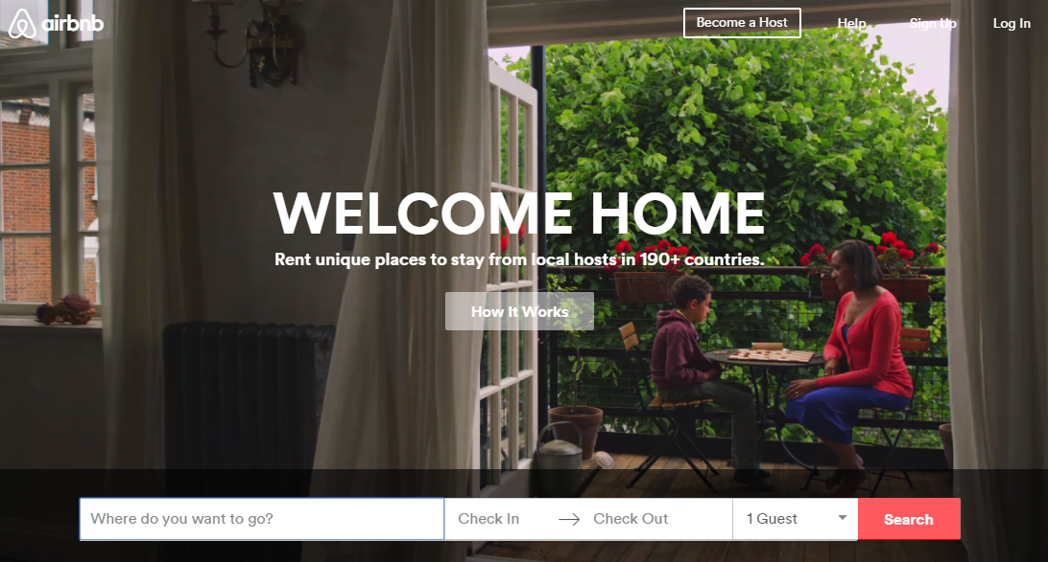
Notes:
Has anyone here ever stayed with Airbnb? Where was the first place you stayed?
Airbnb is a website for people to list, find, and rent lodging
1.5 million listings
34,000 cities
190 countries

Slide 3
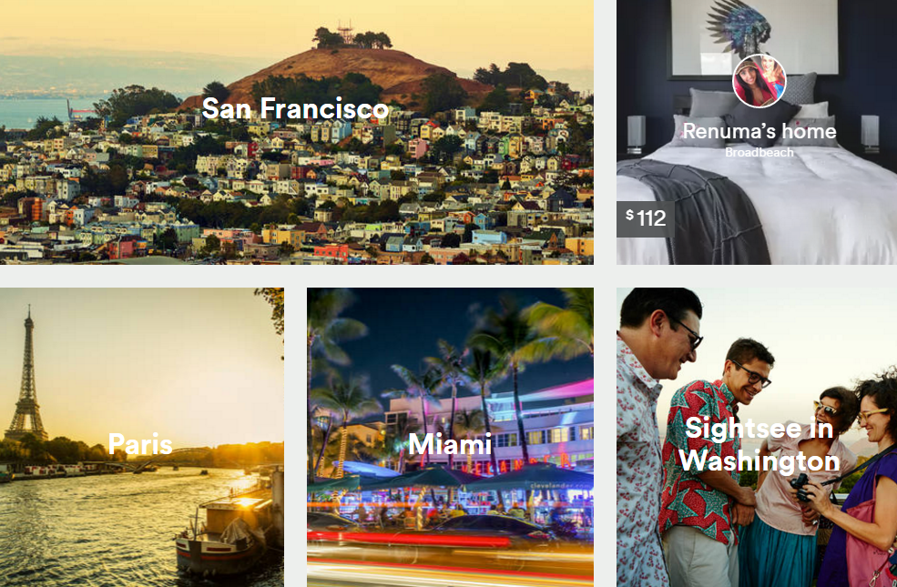
Notes:
Clearly site is designed to inspire wanderlust, global community!
Eye-catching photos of destinations around the world.
Known for being a data driven company, site behavior informs recommendations/customer engagement.
If a first-time user is not captivated, the travel bug may never bite.

Slide 4
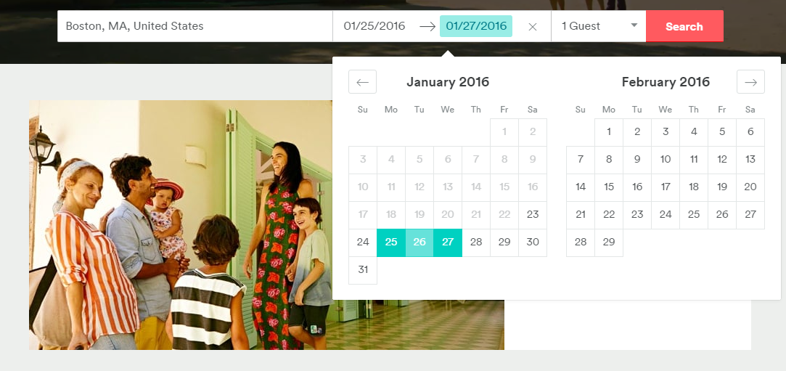
Challenge: Accurately predict where a new user will book first travel experience
Personalize content
Decrease time to first booking
Better forecast demand
Notes:
I chose this project because:
I love to travel
It’s an interesting problem that could translate to a variety of businesses
I thought it would be a straightforward example of Data Science in action!
Data provided through Airbnb/Kaggle

Slide 5

Data provided
Gender
Age
Signup method
Date account created
Timestamp of first activity
Date of first booking
Page viewed before signup
Language preference
Paid marketing type
Marketing provider
First marketing encountered
Signup app
Device type
Browser
Destination country (target)
…and more!
Notes:
I decided to focus on the primary dataset provided, which contained the variables listed here for 213,451 users in the United States.
Destination country target variable provided in the test set contained 12 values:
'US', 'FR', 'CA', 'GB', 'ES', 'IT', 'PT', 'NL','DE', 'AU', 'NDF' (no booking at all), and 'other'

Slide 6
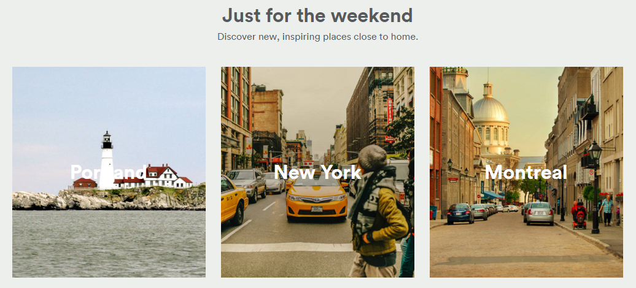
Initial assessment
Classification problem
Supervised
Categorical
Sparse data
58% no booking at all!
30% booked in US
97% English-speaking
45% gender unidentified
41% age unidentified

Slide 7
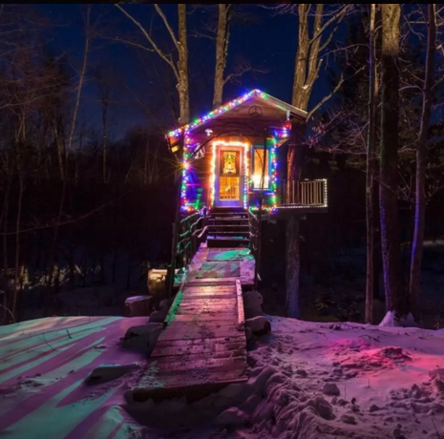
Approach
Data mining and cleaning
Fill missing values
Regroup low-incidence values
Extract info from timestamped features
Convert categorical data to numeric
Choose machine learning algorithms
Decision trees
Ensemble classifiers
Rework features and repeat!
Feature extraction with PCA
K-nearest neighbors

Slide 8
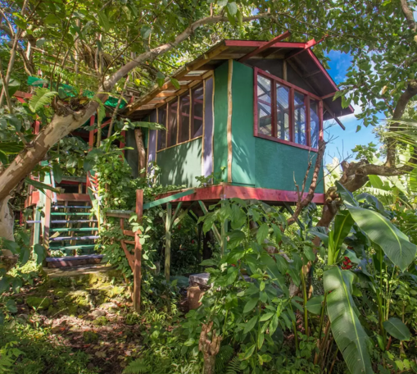
Results
Decision tree model predicted booking location with 87% accuracy
Improved from initial attempt (70%)
Ensemble methods 75-86%
PCA with KNN: 85% accuracy
PCA reduced effectiveness of ensemble classifiers
Most important features:
Month of first booking
Signup channel (web/app)
Marketing provider

Slide 9

Next steps
Improve existing features
Regroup important features
GridSearch
Incorporate new features
Web session info
Country location stats
Try other classifiers
SVM, Logistic regression
Make predictions on test data!

Slide 10
Thank you!
General Assembly instructional team
Paul Burkard, Jon Blum, Marcos Papaleontiou
Data from Airbnb via Kaggle
Photos and company info from Airbnb
Nicole Reitz
nicole.reitz@gmail.com
www.linkedin.com/in/nreitz

